Slide 1
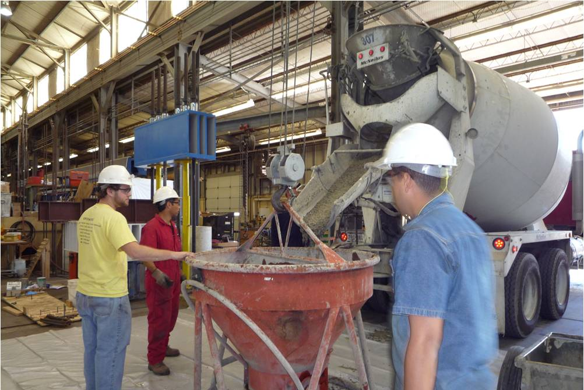
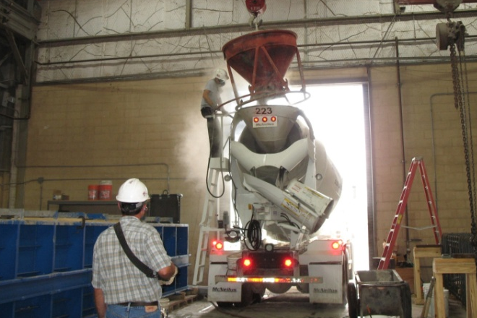
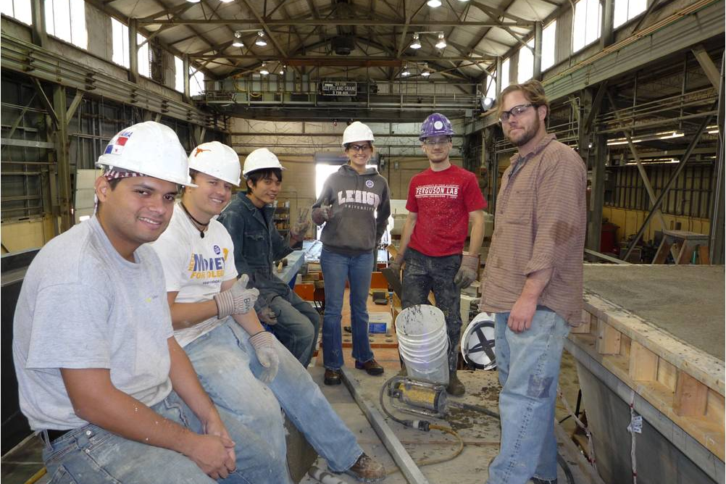

Concrete Measurement and Testing at FSEL
[Bldg 24 Committee]
May 5, 2009

Slide 2
Important Aspects of
Working With Concrete at FSEL
Place an order
Prepare for casting day
Measure concrete properties (e.g., slump)
Cast compression strength cylinders
Be safe!

Slide 3
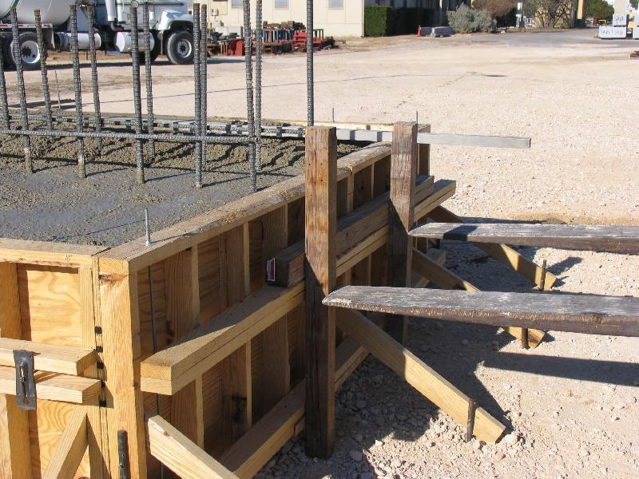
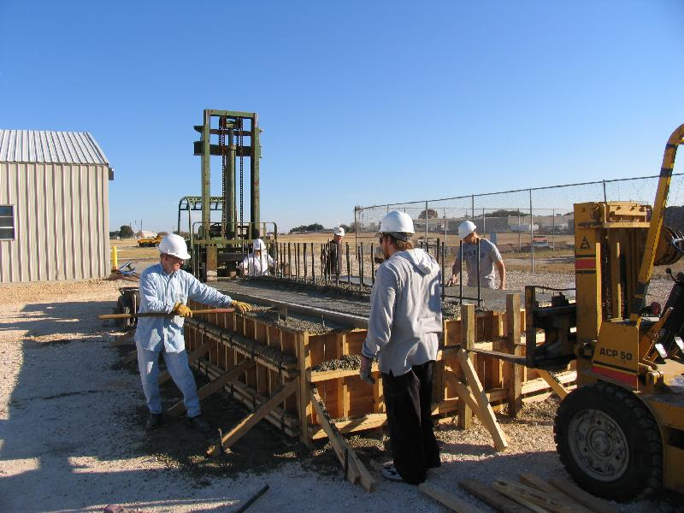
Placing a Concrete Order
Design concrete needed
  Is a certain strength needed by a certain day?
  Will there be a lot of congestion of bars, demanding a high-flow concrete?
Talk to Dennis at least two weeks before desired casting date
Make sure your forms are good!

Slide 4
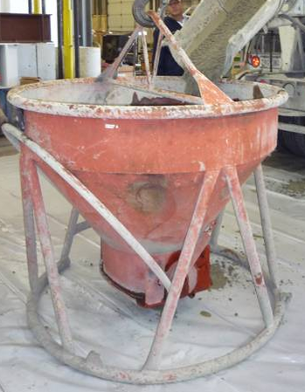

Preparation for Casting Day
Secure forms
Set up scaffolding as needed
Put out all needed tools
Coordinate with the lab techs (crane operators)
Decide if truck is coming in north or east door
Get some volunteers!

Slide 5
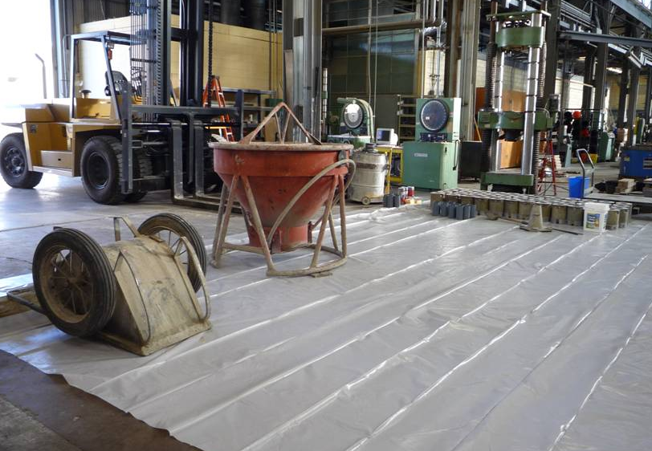
Preparation for Casting Day
Put out all needed tools:
  Large sheet of plastic for entranceway
  Concrete placement bucket
  Slump kit, tamping rod, and measuring tape
  Wheelbarrow
  Shovel
  Cylinder molds and tamping rod
  At least one bucket of water
  At least one empty bucket
  Vibrator(s)
  Screed of appropriate size for item being cast
  Trowels for finishing
  Plastic sheet large enough to fully cover your specimen
concrete bucket
cylinder molds
water bucket
wheelbarrow
slump kit
plastic sheet

Slide 6
Concrete Sampling and Testing
Appropriate concrete is critical for a good test specimen
Characteristics are found by testing in plastic and hardened state
  Slump test indicates workability of the material, and gives an indication of concrete strength when admixtures aren’t used
  Compression cylinders, tested after curing, provide concrete strength through time: f_{ci}', f_{c}', etc.
ASTM provides specifications for all tests
In this presentation:
  concrete sampling (C 172-08)
  slump testing (C 143/C 143M-08)
  cylinder forming (C 192/C 192M-08)
  cylinder testing

Slide 7
Concrete Sampling
For slump testing, concrete should be taken out of the truck before any concrete goes into the bucket or the specimen
If any water or admixture is added, a new test should be run
  Rule of thumb: to increase slump, add 1 gal H₂0 / 1 yd concrete / 1 in. additional slump desired
  Be conservative: water can’t be taken back out
For cylinder casting, concrete should come from the middle of the truck [10%-90% discharged]
  Per ASTM, two samples should be taken within 15 minutes of each other, and then thoroughly mixed together
Leftover slump concrete SHOULD NOT be used
in cylinder molds!

Slide 8
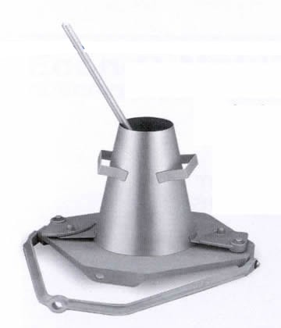
Slump Measurement
Limitations of Use:
Slump should be between ½ in. and 9 in. for this test method
Maximum aggregate size should be less than 1½ in.
Tools Needed:
Slump cone of specific dimensions;
the lab has several
Tamping rod: a round, straight steel rod
5/8 in. in diameter and 24 in. in length,
with at least one end rounded
– NOT REBAR

Slide 9
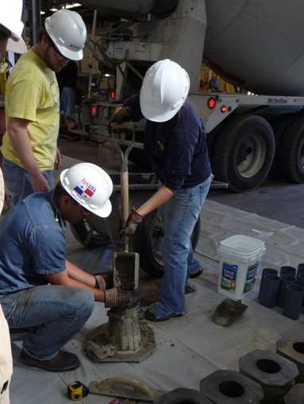
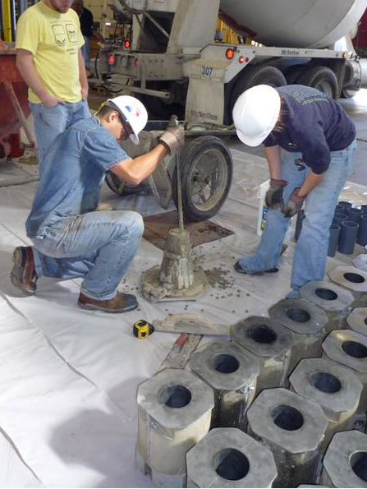
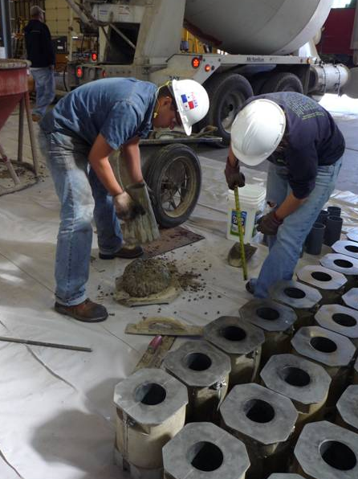
Slump Measurement
Method:
Dampen the base plate and mold
Fill the cone in three lifts, each approximately 1/3 the volume (2 ½ in., 6 in.)
Tamp each lift 25 times
NO TAPPING THE SIDES
Overfill the mold; add more if the level decreases while tamping
Clean off the bottom plate
Open base clamps while preventing mold from lifting prematurely
Remove mold vertically over a time of 5 seconds (+/- 2 seconds)
Entire test should take less than 2 ½ minutes

Slide 10
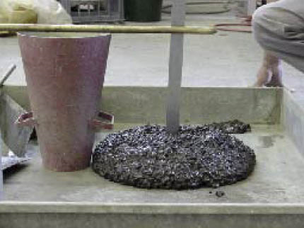
Slump Measurement
“The vertical distance between the original and displaced position of the center of the top surface of the concrete is measured and reported as the slump of the concrete.”
– ASTM C 143/C 143M-08

Slide 11
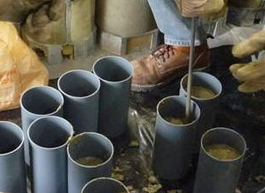
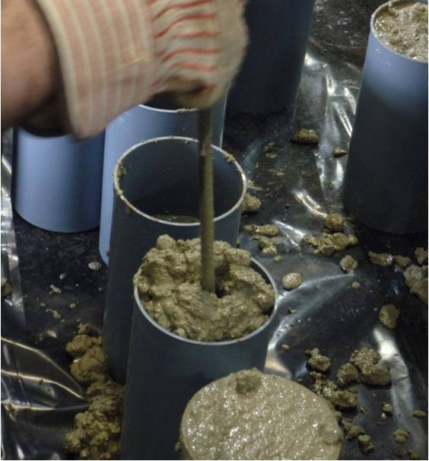
Compression Cylinders
Tools Needed:
Cylinder molds: 4 x 8 in. is typical at FSEL
Tamping rod: 3/8in. in diameter, smooth surface, rounded tips
Trowel (for finishing)
Rubber mallet
Method:
Place concrete in two equal lifts
Tamp each lift 25 times
Tap outside of mold with mallet 10-15 times per lift
Curing:
Store near the specimen (preferably, cast near the specimen, too)
Cure in the same manner as the specimen (e.g., plastic sheet covering)

Slide 12
Safety Concerns with Cement
From ASTM: “Fresh hydraulic cementitious mixtures are caustic and may cause chemical burns to skin and tissue upon prolonged exposure.”
– ASTM C 192/C 192M-07

Slide 13
Testing References
Referenced ASTM Standards:
C 172-08: Standard Practice for Sampling Freshly Mixed Concrete
C 143/C 143M-08: Standard Test Method for Slump of Hydraulic Cement Concrete
C 192/C 192M-07: Standard Practice for Making and Curing Concrete Test Specimens in the Laboratory
Other Useful Standards:
C 31/C 31M-08b: Standard Practice for Making and Curing Concrete Test Specimens in the Field
C 42/C 42M-04: Standard Test Method for Obtaining and Testing Drilled Cores and Sawed Beams of Concrete
AASHTO methods and practices

Slide 14
Future Concrete Testing Sessions
SureCure match-cure cylinder system
Compression testing machines available
Working with Type III cement
Measurement of air content by the pressure and volumetric methods
What would you like to learn about?

