Slide 1
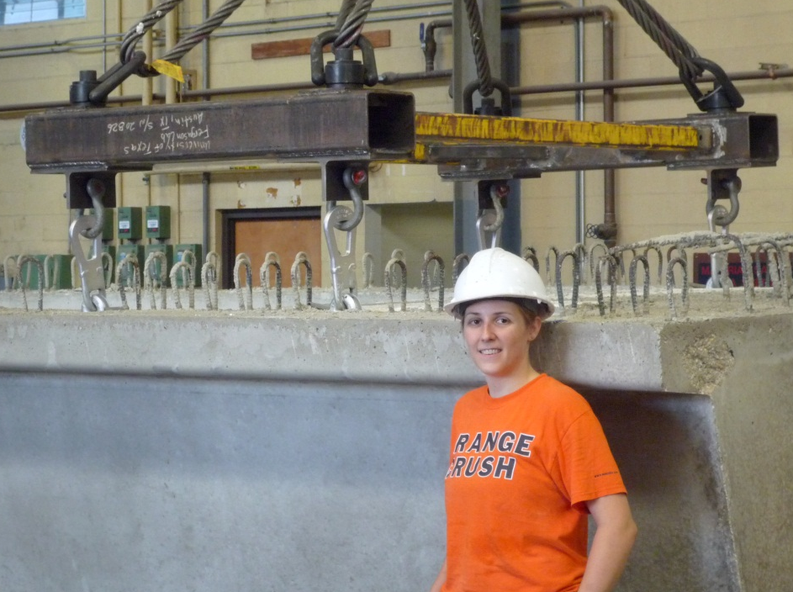

Bridging the Gap:
Answering Questions Through Research
Catherine Hovell, PhD
October 1, 2012
…one direction a UVa degree
can take you …

Slide 2
Flow of Test Program
Can we __________________________?
What about _______________________?
What happens if ____________________?

Slide 3
Flow of Test Program
Can we optimize the end-region of Texas U-Beams?
  ease construction
  maintain structural performance

Slide 4
Flow of Test Program
Literature Review:
  What previous testing has been done?
  What is the current performance of the structure?

Slide 5
Flow of Test Program
build test specimens
test those specimens

Slide 6
Flow of Test Program
build test specimens
compare results to predictions
gather results
test those specimens

Slide 7

Flow of Test Program
build test specimens
compare results to predictions
gather results
test those specimens

Slide 8
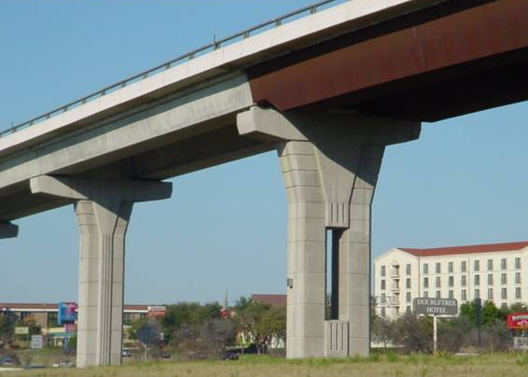
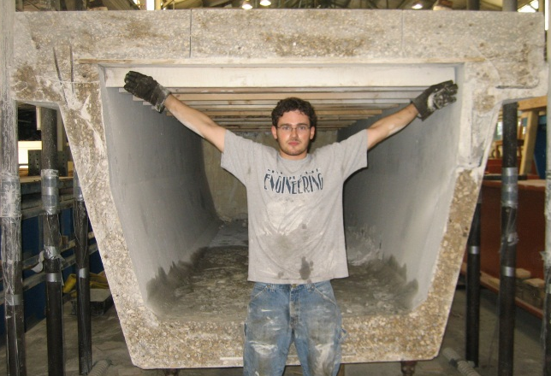
Introduction to the Texas U-Beam
Designed in the 1990s as an "aesthetically pleasing" alternative for use in highly visible interchanges

Slide 9
Introduction to the Texas U-Beam
96"
5"
54"
4
1
55"

Slide 10
Flow of Test Program
Can we optimize the end-region of Texas U-Beams?
  ease construction
  maintain structural performance

Slide 11
Flow of Test Program
Literature Review:
  What previous testing has been done?

Slide 12
Flow of Test Program
Literature Review:
  What previous testing has been done?
    …on U-Beams
    …under shear load

Slide 13
Flow of Test Program
Literature Review:
  What previous testing has been done?
    …on U-Beams
    …under shear load
Box-Beam
23 (2%)
Rectangular
299 (26%)
I-Beam
677 (59%)
T-Beam
139 (12%)
[ data from UTPCSDB Filtered Database, N = 1138 ]

Slide 14
Flow of Test Program
Literature Review:
  What previous testing has been done?
    …on U-Beams
    …under shear load
  What is the current performance of the structure?
- not much
- no tests of U-Beams

Slide 15
Expectations:
Shear Strength
University of Texas Prestressed Concrete Shear Database (2011 Edition) [ UTPCSDB-2011 ]
  99 references from 1954-2010
  shear studies from US, Europe, Japan
Used to create an Evaluation Database answering the question – how accurate is the code equation for shear capacity?

Slide 16


Expectations:
Shear Strength
$$\frac{V_{test}}{V_{n}}$$
conservative
Concrete Strength [ksi]
$V_{n}$ calculated using AASHTO LRFD General Procedure (2010)

Slide 17
Expectations:
Shear Strength
each dot represents a
single laboratory test –
one beam, loaded to failure
$$\frac{V_{test}}{V_{n}}$$
conservative
Concrete Strength [ksi]
$V_{n}$ calculated using AASHTO LRFD General Procedure (2010)

Slide 18
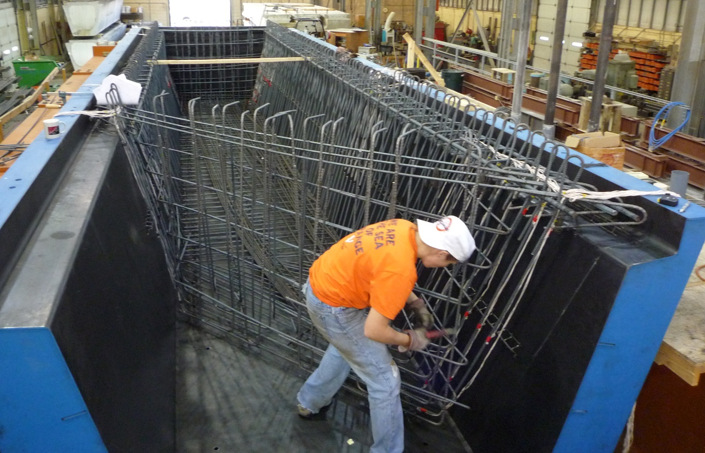
Beam Fabrication
tie reinforcement

Slide 19
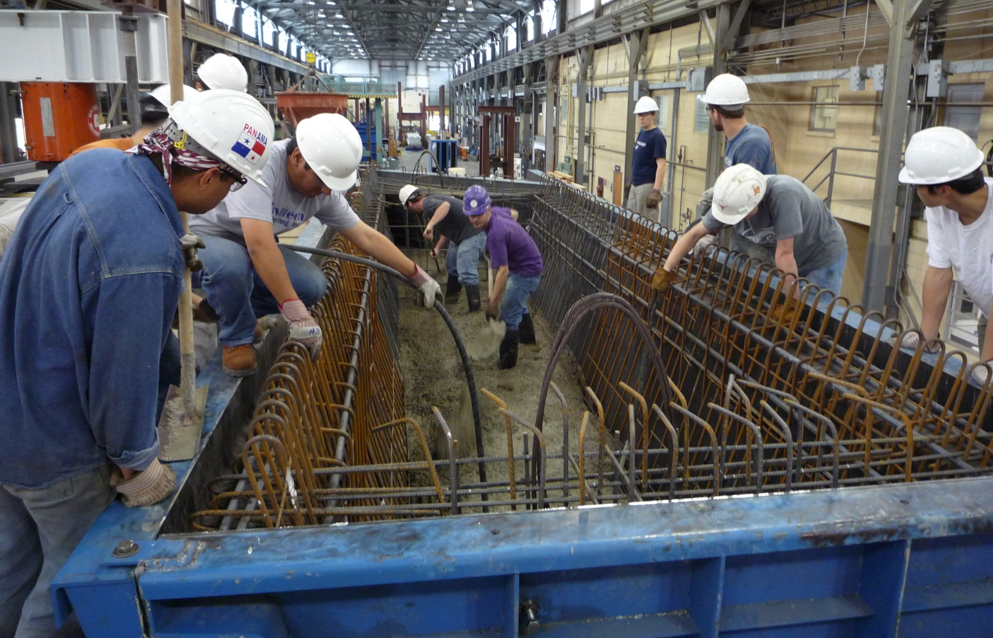
Beam Fabrication
place concrete: fill bottom slab

Slide 20
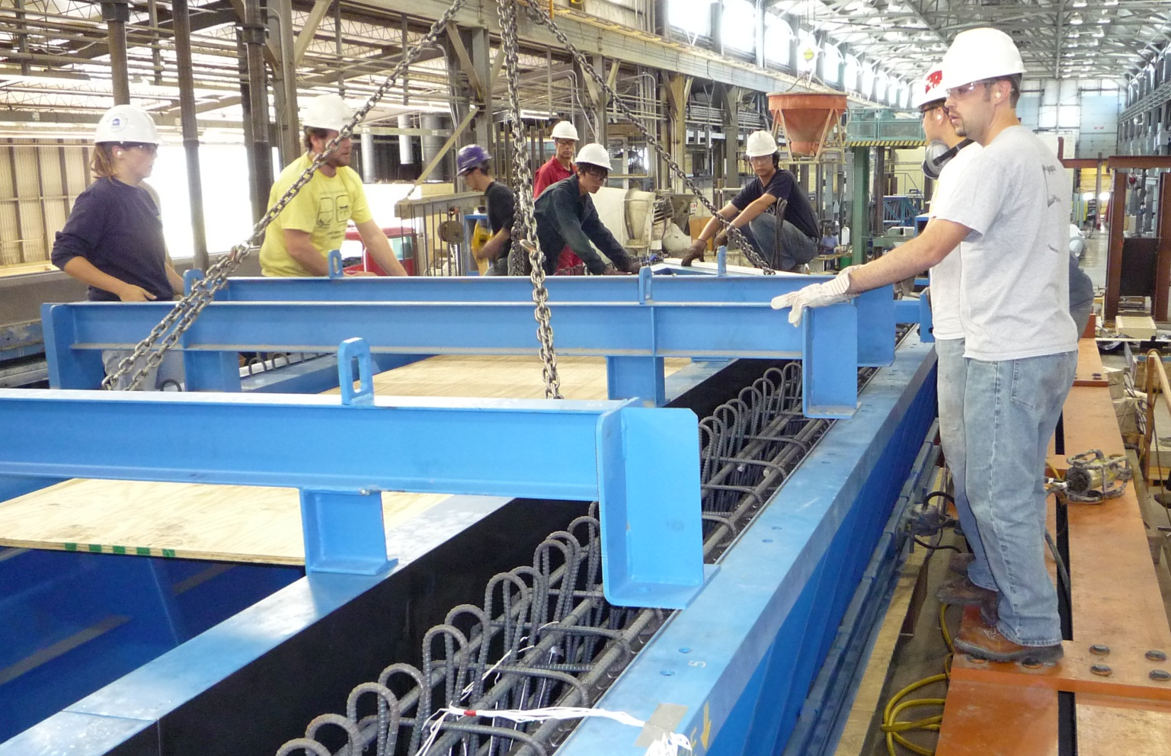
Beam Fabrication
place concrete: place void form

Slide 21
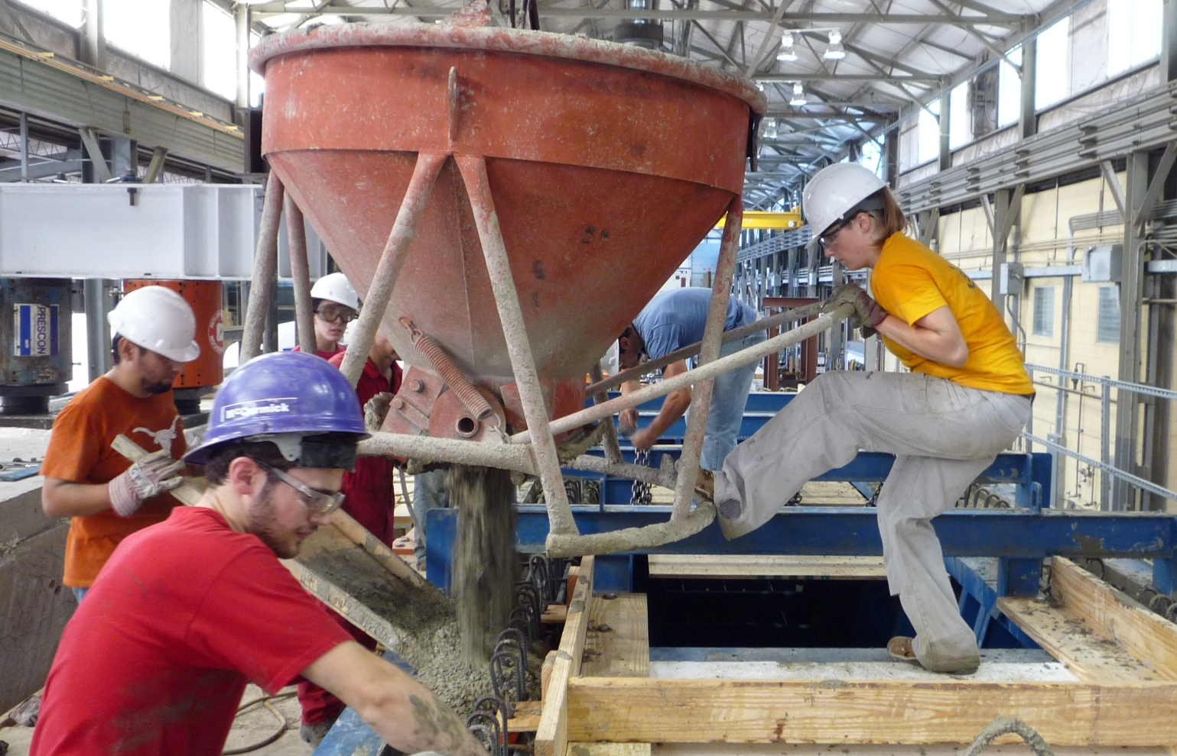
Beam Fabrication
place concrete: fill webs

Slide 22
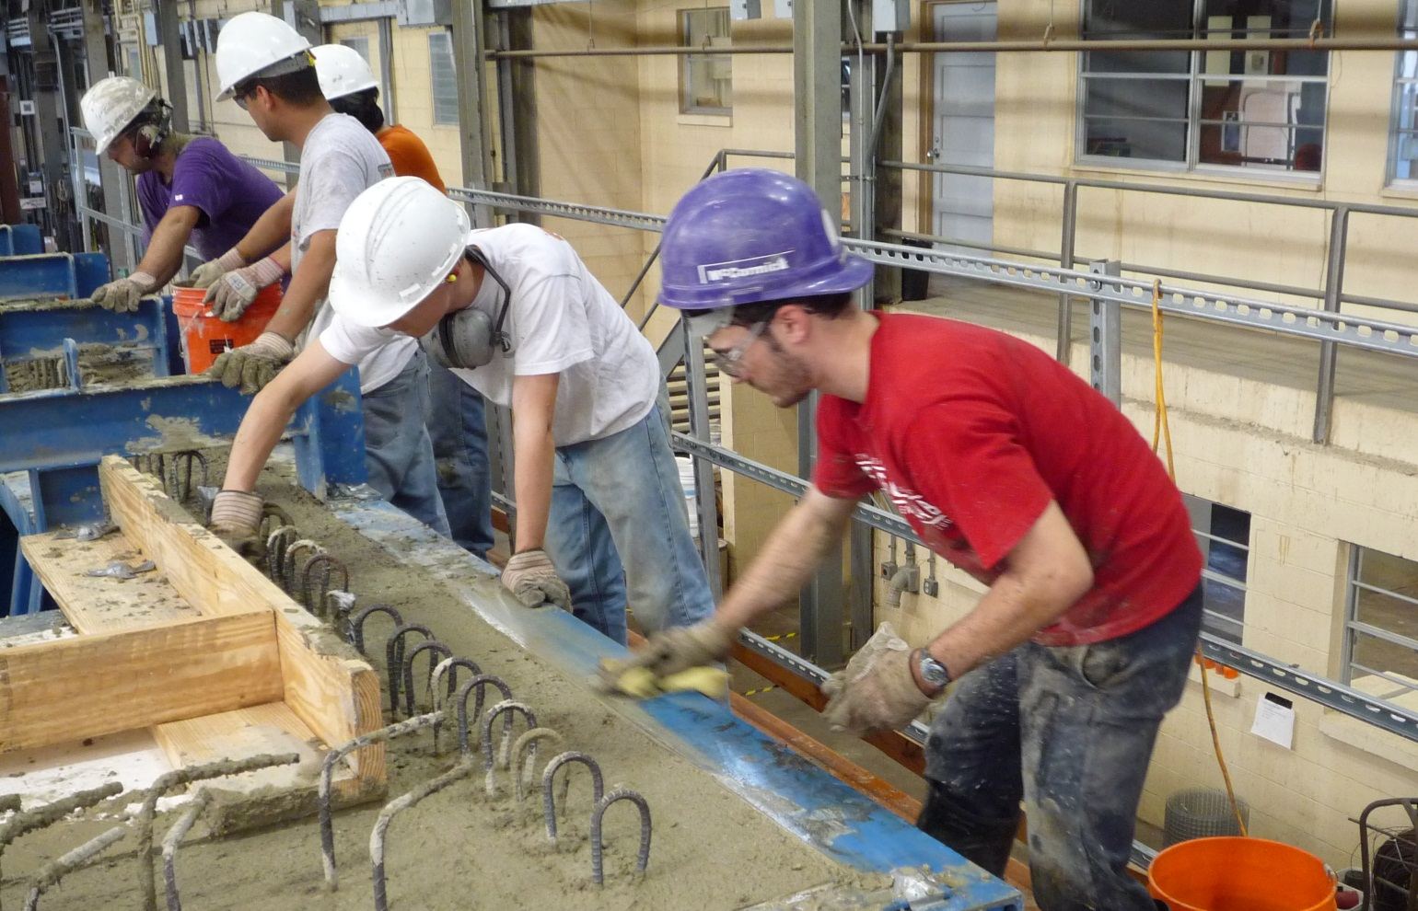
Beam Fabrication
place concrete: clean up

Slide 23
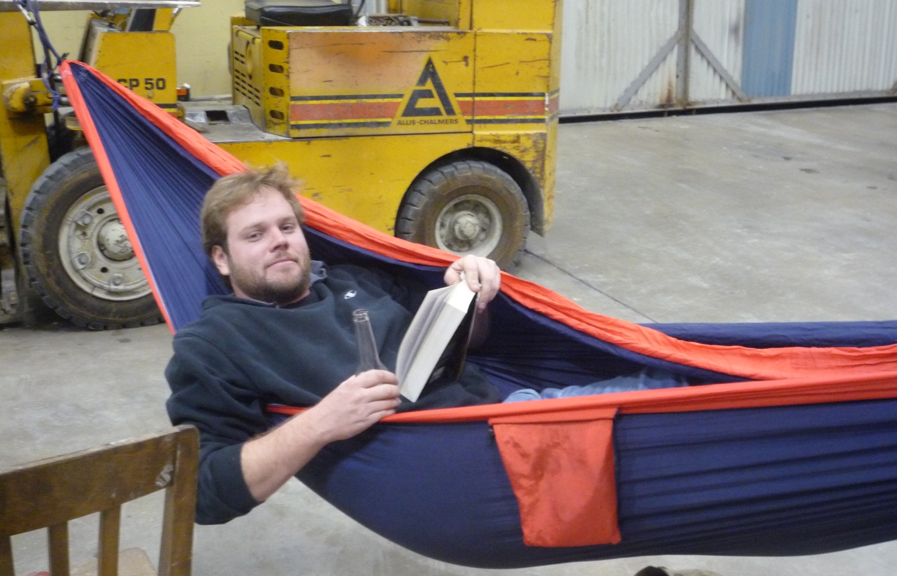
Beam Fabrication
…wait…

Slide 24
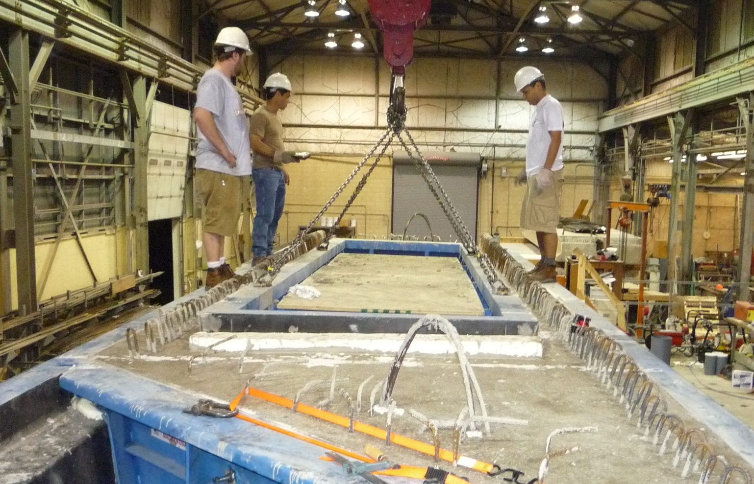
Beam Fabrication
strip forms

Slide 25
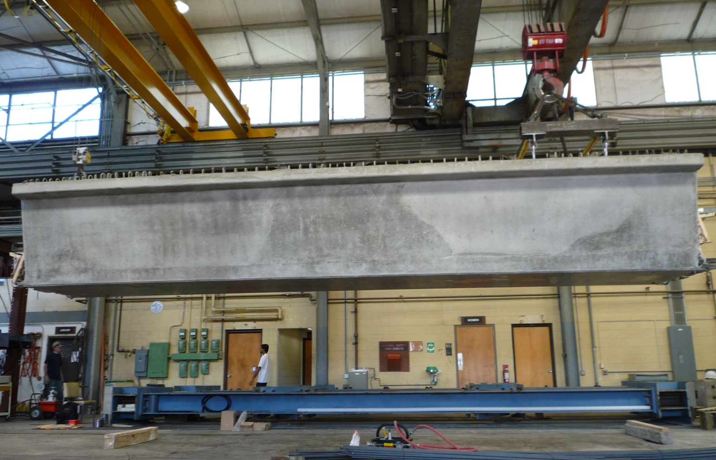
Beam Fabrication
beam is complete!

Slide 26
Shear Test Setup
Reaction structure
TEST REGION
Hydraulic rams
bars at 4 in.
bars at 6 in.
post-tensioned clamps

Slide 27
Shear Test Setup
Reaction structure
TEST REGION
Hydraulic rams
bars at 4 in.
FAILURE ZONE
bars at 6 in.
post-tensioned clamps

Slide 28
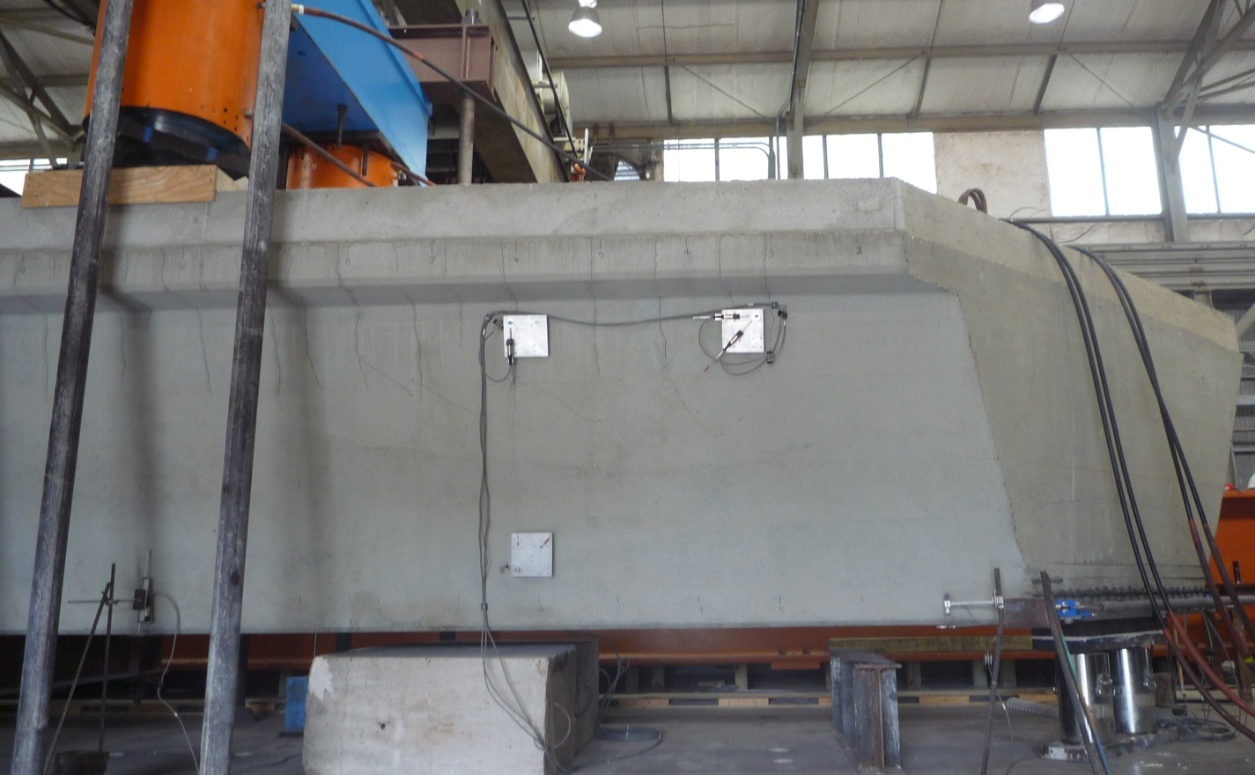
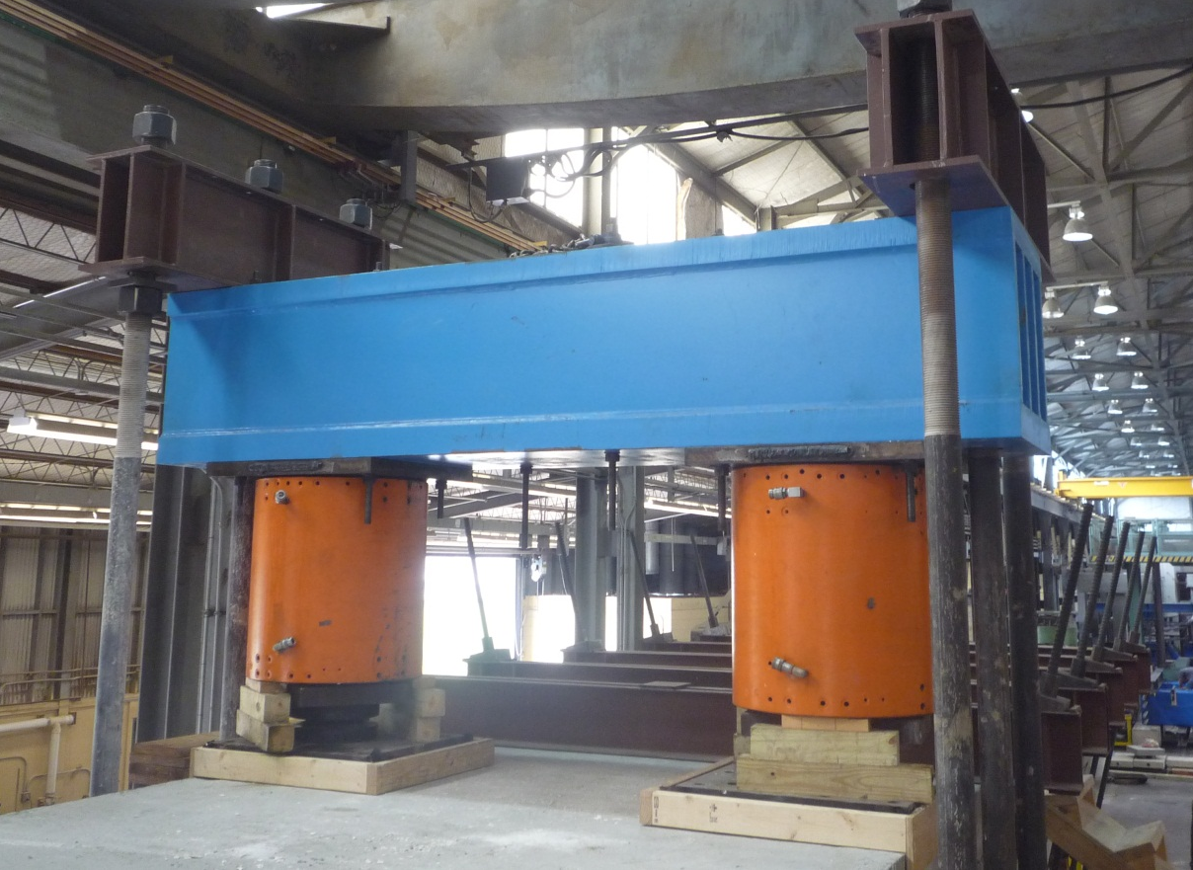
Shear Test Setup

Slide 29
STEP 1:
Establish Current Behavior

Slide 30
Beams 1 and 2
Beam 1
Beam 2
B1N
B1S
B2N
B2S
Failure could not be reached

Slide 31
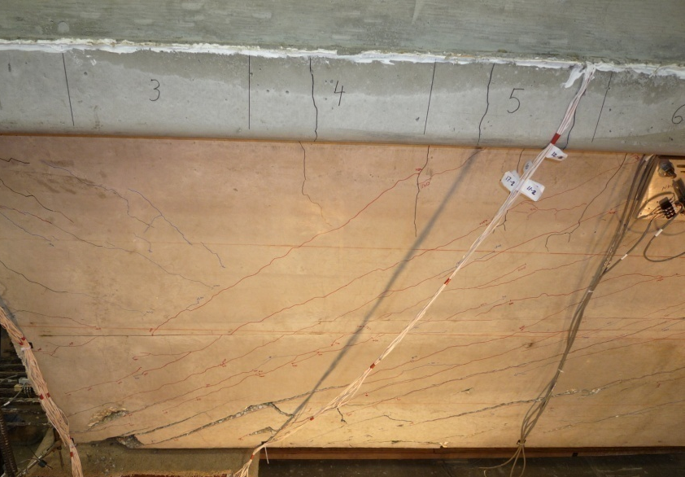
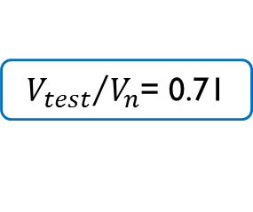


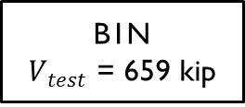


Shear Performance: B1N
#4 stirrups spaced at:
  4 in. for 6'-3"
  6 in. for 7'-1"
${V_{test}}/{V_{n}}$= 0.71
B1N
$V_{test}$ = 659 kip
$$V_{n}$$
Shear Force
$$V$$
$$V_{test}$$
$\frac{V_{test}}{V_{n}}$ = [0.71]
[0.89]
Distance from Beam End

Slide 32
Shear Performance: B1N
$$\frac{V_{test}}{V_{n}}$$
conservative
B1N
Concrete Strength [ksi]
$V_{n}$ calculated using AASHTO LRFD General Procedure (2010)

Slide 33
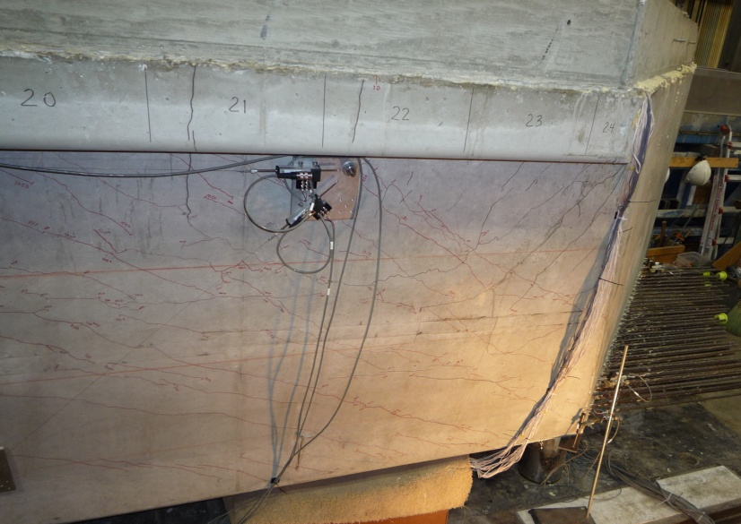


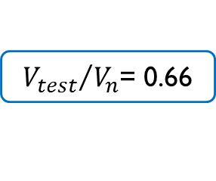


Shear Performance: B1S & B2N
B1S
${V_{test}}/{V_{n}}$= 0.66
$$V_{n}$$
Shear Force
$$V$$
$$V_{test}$$
$\frac{V_{test}}{V_{n}}$ = [0.82]
[0.66]
Distance from Beam End

Slide 34
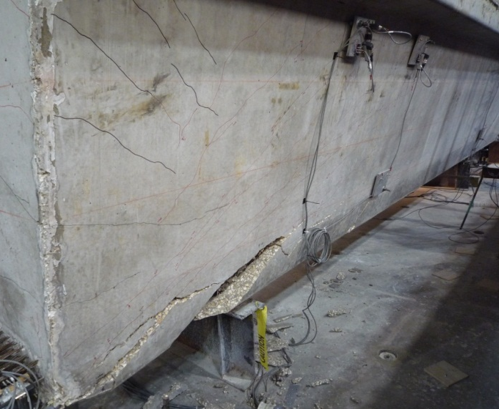

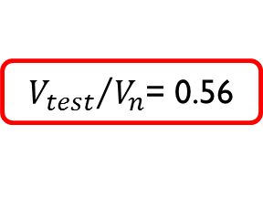

Shear Performance: B1S & B2N
B1S
${V_{test}}/{V_{n}}$= 0.66
$$V_{n}$$
$$V$$
Shear Force
$$V_{test}$$
$\frac{V_{test}}{V_{n}}$ = [0.82]
[0.66]
Distance from Beam End
$$V_{n}$$
${V_{test}}/{V_{n}}$= 0.56
B2N
Shear Force
$$V$$
$$V_{test}$$
$\frac{V_{test}}{V_{n}}$ = [0.56]
[0.72]
Distance from Beam End

Slide 35
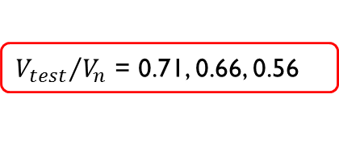
Shear Test Setup
B1S
TEST REGION
bars at 4 in.
B2N
EXPECTED
FAILURE ZONE
ACTUAL
FAILURE ZONE
bars at 6 in.
${V_{test}}/{V_{n}}$ = 0.71, 0.66, 0.56

Slide 36
Intermediate Analysis
These beams are not failing in web-shear
  Comparing failure shear with code web-shear capacity is inappropriate
Are we testing the worst-case scenario?
Beam 3
Contains 42 0.5-in. strands (instead of 78)
B3N
B3S

Slide 37
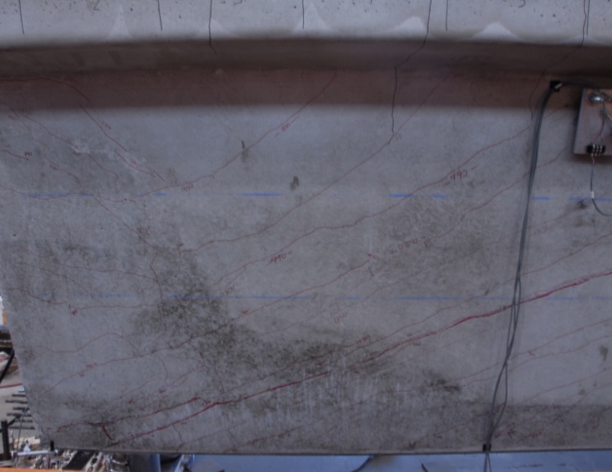
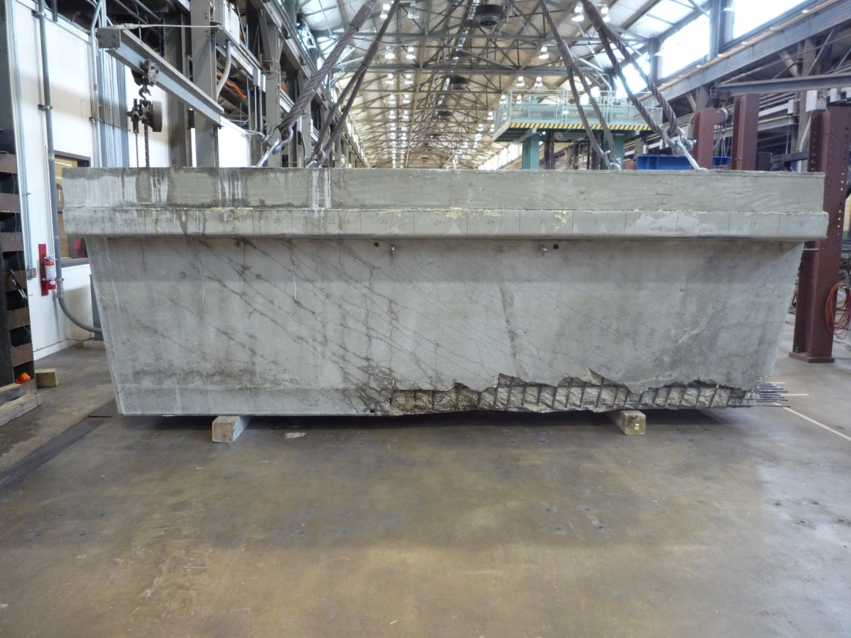




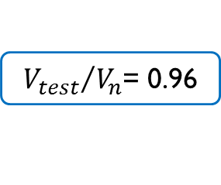
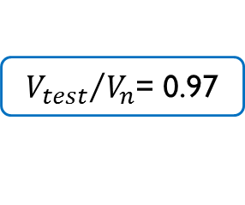




Shear Performance: B3N & B3S
B3N
${V_{test}}/{V_{n}}$= 0.96
$$V$$
$$V_{test}$$
Shear Force
$$V_{n}$$
$\frac{V_{test}}{V_{n}}$ = [0.96]
[1.07]
Distance from Beam End
${V_{test}}/{V_{n}}$= 0.97
B3S
$$V_{test}$$
$$V$$
Shear Force
$$V_{n}$$
[0.97]
$\frac{V_{test}}{V_{n}}$ = [1.08]
Distance from Beam End

Slide 38


Comparison of Failure Shears
659 k
655k
663 k
612 k
610 k
Failure Shear, $V_{test}$ [kip]
0.71
0.66
0.56
0.96
0.97
$${V_{test}}/{V_{n}}$$
B1N
B1S
B2N
B3N
B3S

Slide 39
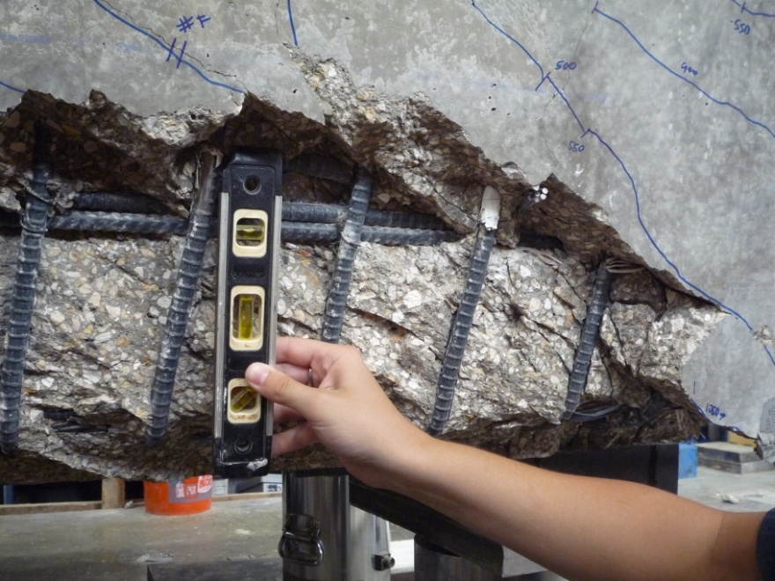
Shear Performance: B3S
B3S

Slide 40

Horizontal Shear
P
$V$
reinforcement

Slide 41

Horizontal Shear
P
$V$

Slide 42
Horizontal Shear
P
$V$

Slide 43
Flow of Test Program
Can we optimize the end-region of Texas U-Beams?
  ease construction
  maintain structural performance
Can we improve the end-region design of Texas U-Beams to increase
horizontal shear capacity and allow web-shear to control behavior?

Slide 44
STEP 2:
Design Beams for Better Behavior

Slide 45
Test Region B4N
R-bar
modified cross-section
confinement steel
#4 R-bars spaced at 3 in. for 5'-0"
4 in. for 5'-0"
6 in. for 3'-4"

Slide 46
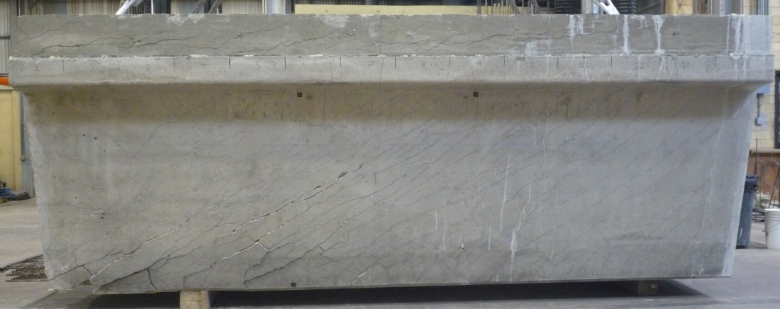

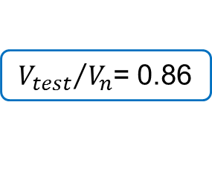

Test Region B4N
B4N
horizontal shear with some web crushing
$$V_{n}$$
#4 R-bars spaced at 3 in. for 5'-0"
4 in. for 5'-0"
6 in. for 3'-4"
$$V_{test}$$
Shear Force
$\frac{V_{test}}{V_{n}}$ = [0.86]
[0.93]
[1.12]
${V_{test}}/{V_{n}}$= 0.86
Distance from Beam End

Slide 47
Test Region B4S
R-bar
modified cross-section
supplementary bottom flange-to-web steel
(L-bars)
confinement steel
#4 R-bars spaced at 3 in. for 5'-0"
4 in. for 5'-0"
6 in. for 3'-4"
3-#5 L-bars spaced at 3 in. for 5'-0"
4 in. for 2'-8"

Slide 48
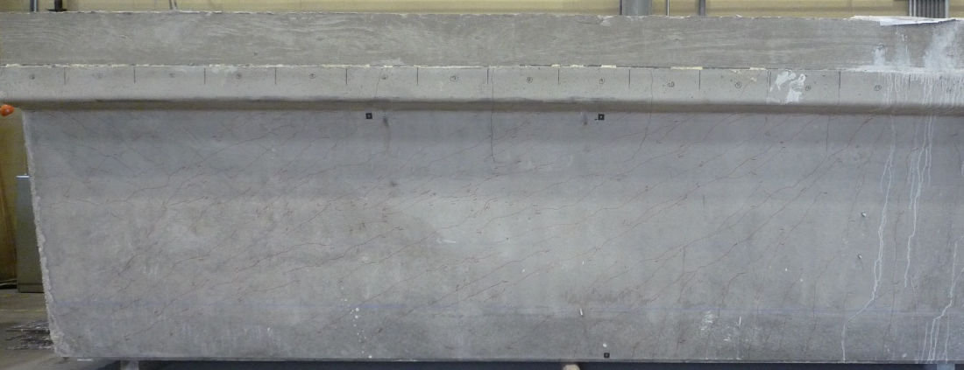
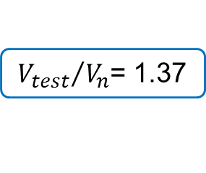
Test Region B4S
B4S
test halted before failure
No L-bars
#4 R-bars spaced at 3 in. for 5'-0"
4 in. for 5'-0"
6 in. for 3'-4“
3-#5 L-bars spaced at 3 in. for 5'-0"
4 in. for 2'-8"
Shear Force
[1.05]
[1.14]
[1.37]
${V_{test}}/{V_{n}}$= 1.37
Distance from Beam End

Slide 49
Test Region B5N
R-bar
supplementary bottom flange-to-web steel
(L-bars)
confinement steel
#5 R-bars spaced at 4 in. for 8'-3"
6 in. for 5'-1"
#6 L-bars spaced at 4 in. for 8'-3"

Slide 50
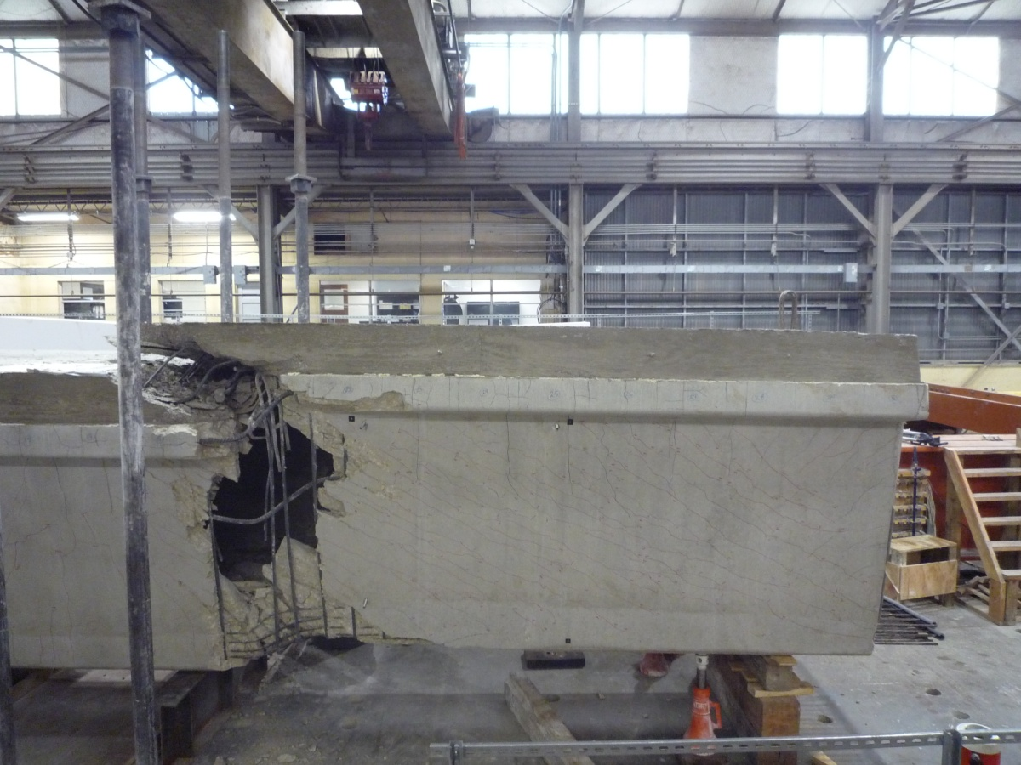
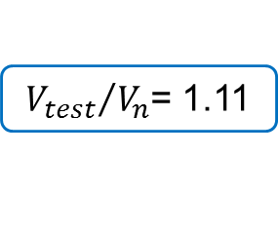
Test Region B5N
B5N
flexure-shear
6 in. spacing, no L-bars
#5 R-bars spaced at 4 in. for 8'-3"
6 in. for 5'-1"
#6 L-bars spaced at 4 in. for 8'-3"
Shear Force
[1.00]
[1.11]
${V_{test}}/{V_{n}}$= 1.11
Distance from Beam End

Slide 51
Recommended New Design
standard cross-section
#4 R-bars (stirrups)
2-#5 L-bars (supplementary steel)
#4 C-bars (confinement)

Slide 52
Recommended New Design
CURRENT STANDARD
2'-0" to 2'-6"
for beams with skew > 30°
1'-6" to 2'-0"
for beams with skew < 30°
RECOMMENDED
STANDARD
3'-0" to 3'-6"
2'-6" to 3'-0"

Slide 53
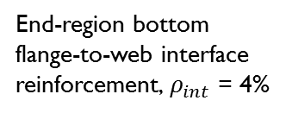
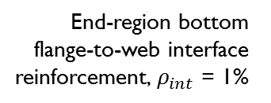
Recommended New Design
End-region bottom
flange-to-web interface reinforcement, $ρ_{int}$ = 1%
R-bar
CUT
L-bars
EXISTING TEXAS
U-BEAM STANDARD
Square end block length: 1'-6" to 2'-0"
RECOMMENDED NEW TEXAS U-BEAM STANDARD
R-bar
End-region bottom
flange-to-web interface reinforcement, $ρ_{int}$ = 4%
End block vertical reinforcement
(V- and F-bars)
Square end block length: 2'-6" to 3'-0"

Slide 54
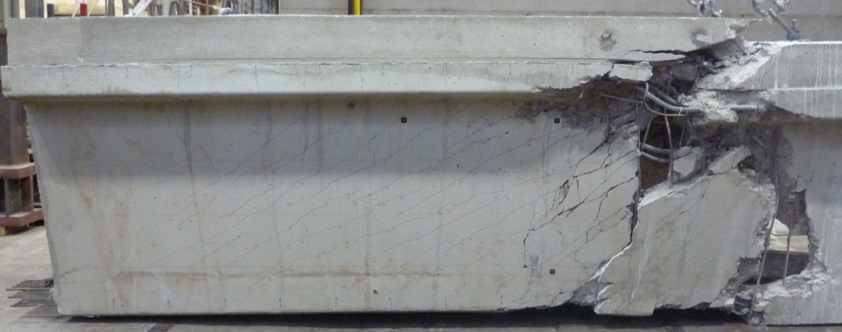
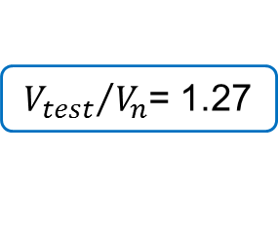
Test Region B6S
B6S
flexure-shear
6 in. spacing, no L-bars
#4 R-bars spaced at 4 in. for 8'-3"
6 in. for 5'-1"
2-#5 L-bars spaced at 4 in. for 8'-3"
Shear Force
[1.09]
[1.27]
${V_{test}}/{V_{n}}$= 1.27
Distance from Beam End

Slide 55
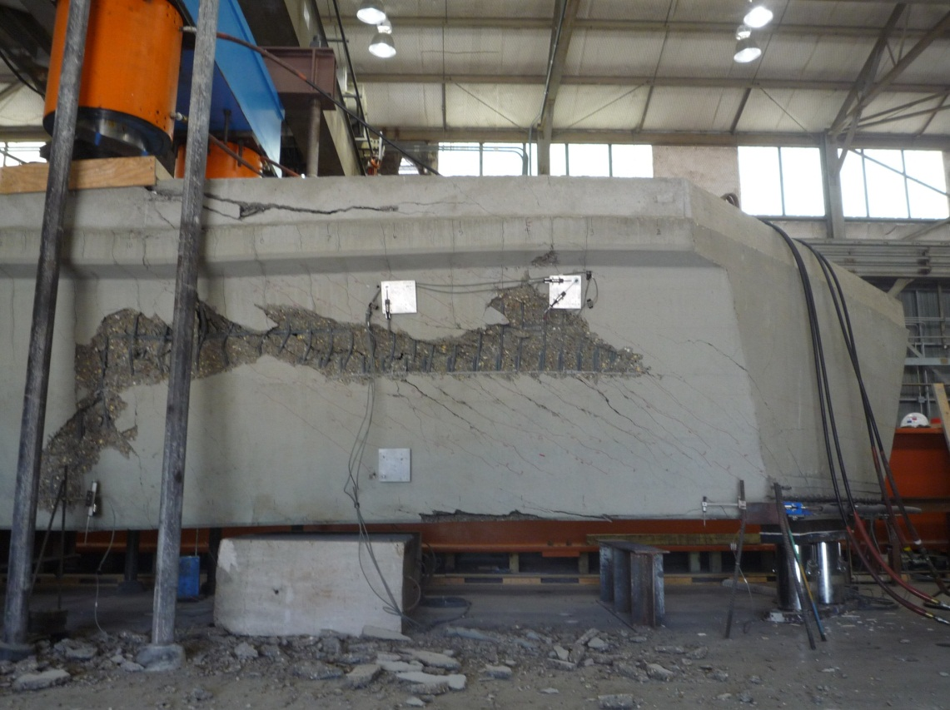
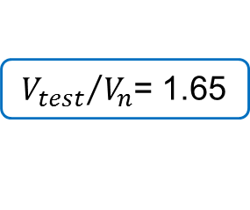
Test Region B7N
B7N
web crushing
6 in. spacing, no L-bars
#4 R-bars spaced at 4 in. for 8'-3"
6 in. for 5'-1"
2-#5 L-bars spaced at 4 in. for 8'-3"
Shear Force
[1.33]
[1.65]
${V_{test}}/{V_{n}}$= 1.65
Distance from Beam End

Slide 56

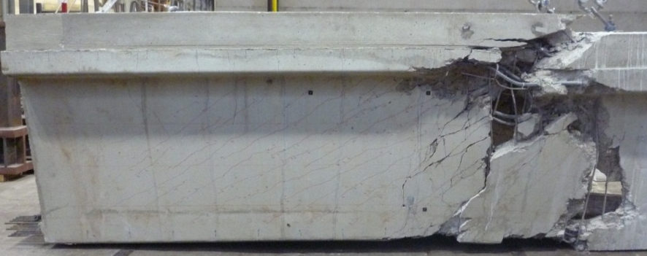
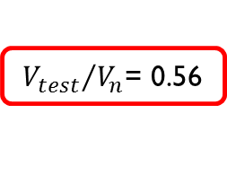
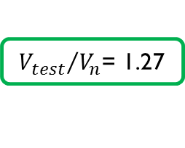
Effect of Design Changes
B2N
B6S
${V_{test}}/{V_{n}}$= 0.56
Shear Force
Shear Force
${V_{test}}/{V_{n}}$= 1.27
[0.56]
[0.72]
[1.09]
[1.27]
Distance from Beam End
Distance from Beam End
Horizontal Shear Failure
Flexure-Shear Failure

Slide 57
Comparison to the Literature
$$\frac{V_{test}}{V_{n}}$$
conservative
Concrete Strength [ksi]
$V_{n}$ calculated using AASHTO LRFD General Procedure (2010)

Slide 58
Comparison to the Literature
B6S
B7N
$$\frac{V_{test}}{V_{n}}$$
B5N
conservative
Concrete Strength [ksi]
$V_{n}$ calculated using AASHTO LRFD General Procedure (2010)

Slide 59
Bridging the Gap
[ or, Filling Holes in the Literature ]

Slide 60
New Data in Literature
Shear Test Program
Box-Beam
23 (2%)
U-Beam
11 (1%)
Rectangular
299 (26%)
I-Beam
677 (59%)
T-Beam
139 (12%)
[ data from UTPCSDB Filtered Database, N = 1138 ]

Slide 61
New Data in Literature
Shear Test Program
2%
Specimen Depth [in.]
50%
Year of Testing
[ data from UTPCSDB Filtered Database, N = 1138 ]

Slide 62
New Data in Literature
Shear Test Program
U-Beams: 62.75 in.
2%
Specimen Depth [in.]
50%
Year of Testing
[ data from UTPCSDB Filtered Database, N = 1138 ]

Slide 63
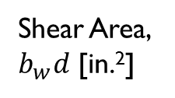
New Data in Literature
Shear Test Program
Shear Area, $b_{w}d$ [in.²]
1%
60%
Year of Testing
[ data from UTPCSDB Filtered Database, N = 1138 ]

Slide 64
New Data in Literature
Shear Test Program
U-Beams:
550 to 940 in.²
Shear Area, $b_{w}d$ [in.²]
1%
60%
Year of Testing
[ data from UTPCSDB Filtered Database, N = 1138 ]

Slide 65
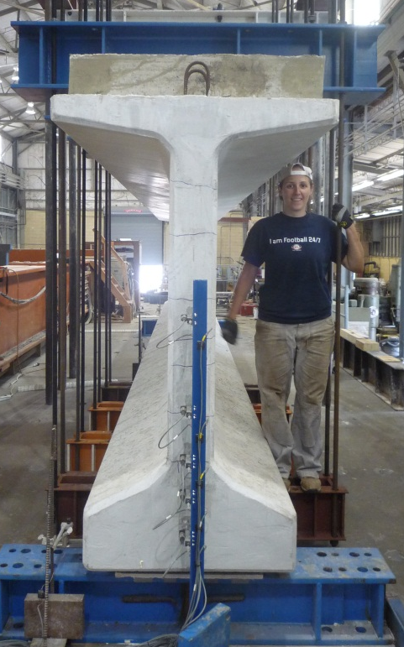
Conclusions & Advice
Research is a fluid, cyclic process; the original question asked may become unimportant by the end
Don’t be afraid to think outside the box – just because something “should be” doesn’t mean it “is”
Equations learned in class were developed somewhere, verified somehow; it’s nice to know where and how
Getting involved, hands-on, is the best way to understand how something works

Slide 66
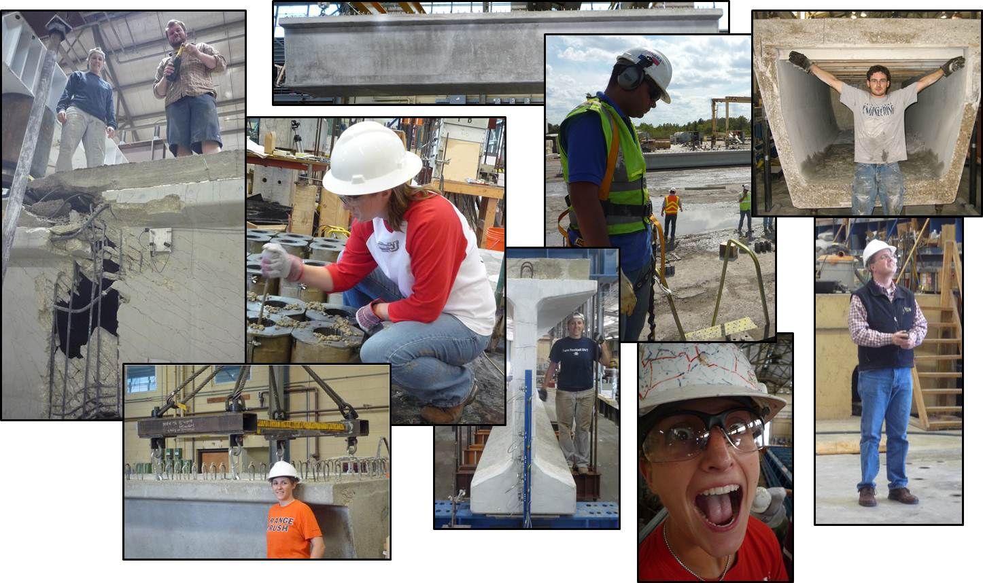
Questions or Comments?

Slide 67
SHEAR STRENGTH:
Horizontal Shear in Prestressed Beams

Slide 68


Horizontal Shear in Prestressed Beams
To verify method, compared demand to capacity at a single point for laboratory tests
P
$A_{vf}f_{y}$
$τ$
$V$
Find horizontal stress on interface and use it to calculate demand
Calculate capacity following shear-friction theory, giving credit to cohesion between concrete sections and clamping force from reinforcement

Slide 69






Calculation Method
Horizontal Shear Demand:
$$V_{u_{hs}}=v_{hs}b_{w}\left(l_{UEP}−oh\right)$$
distance from centerline
of bearing pad to the
ultimate evaluation point
average horizontal shear stress
$$l_{LP}$$
$$h$$
45°
UEP
$$y_{crit}$$
$$oh$$
$$a$$
$$l_{UEP}$$

Slide 70

Calculation Method
Definition of average horizontal shear stress:
$$v_{hs}=v_{avg}=\frac{V}{b_{w}d}=τ$$
Non-linear analyses showed that average stress was a reasonable approximation of the stress at the critical interface
Complementary property of shear

Slide 71

Calculation Method
Horizontal Shear Capacity:
$$V_{ni}=k_{d}\left[cA_{cv}+μ\left(A_{vf}f_{y}−0.04P_{PS}\right)\right]$$
concrete
cohesion term
prestress
transfer penalty
steel friction / clamping term
beam shape / reinforcement detailing factor

Slide 72
Calculation Method
Horizontal Shear Capacity:
$$V_{ni}=k_{d}\left[cA_{cv}+μ\left(A_{vf}f_{y}−0.04P_{PS}\right)\right]$$
AASHTO shear friction equation

Slide 73
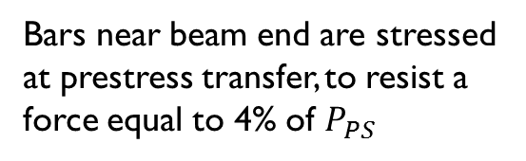
Calculation Method
Horizontal Shear Capacity:
$$V_{ni}=k_{d}\left[cA_{cv}+μ\left(A_{vf}f_{y}−0.04P_{PS}\right)\right]$$
prestress
transfer penalty
Bars near beam end are stressed at prestress transfer, to resist a force equal to 4% of $P_{PS}$

Slide 74
Calculation Method
Horizontal Shear Capacity:
$$V_{ni}=k_{d}\left[cA_{cv}+μ\left(A_{vf}f_{y}−0.04P_{PS}\right)\right]$$
beam shape / reinforcement detailing factor

Slide 75
Horizontal Shear Evaluation Database
Subset of UTPCSDB Evaluation-Level I Database
Specimens removed if:
  post-tensioned
  rectangular or T-shaped
  non-standard beam section
  skewed beam
  insufficient reinforcement information available
HSED contains 69 data points
(including 8 U-Beams)

Slide 76
Horizontal Shear Evaluation Database
Texas 4B28
AASHTO Type I
AASHTO Type II
Texas
Type C
AASHTO Type II
with deck
AASHTO Type III
with deck
Minnesota
Type 54
Texas Tx70
with deck
PCI BT-63
with deck
Minnesota
Type 54 with deck
Texas Tx46 with deck
PCEF-45
Texas Tx28 with deck
Texas 5B40
Texas 5XB40
with deck
Texas U54 with deck
Texas Modified U54
with deck

Slide 77
Horizontal Shear Evaluation
horizontal shear damage expected
1.0
$$\frac{V_{u_{hs}}}{V_{ni}}$$
exceed calculated shear capacity
1.0
$${V_{test}}/{V_{n}}$$
[calculated using AASHTO General Procedure]

Slide 78
Horizontal Shear Evaluation
U-Beams
[ Phase I ]
horizontal shear damage expected
1.0
U-Beams
[ Phase II ]
$$\frac{V_{u_{hs}}}{V_{ni}}$$
most beam tests
exceed calculated shear capacity
1.0
$${V_{test}}/{V_{n}}$$
[calculated using AASHTO General Procedure]

Slide 79
Horizontal Shear Evaluation
$$\frac{V_{u_{hs}}}{V_{ni}}$$
NO horizontal shear damage
$${V_{test}}/{V_{n}}$$
[calculated using AASHTO General Procedure]

Slide 80
Horizontal Shear Evaluation
$$\frac{V_{u_{hs}}}{V_{ni}}$$
SOME horizontal shear damage
$${V_{test}}/{V_{n}}$$
[calculated using AASHTO General Procedure]

Slide 81
Horizontal Shear Evaluation
$$\frac{V_{u_{hs}}}{V_{ni}}$$
Some Horizontal Shear Damage
No Horizontal Shear Damage
$${V_{test}}/{V_{n}}$$
[calculated using AASHTO General Procedure]

Slide 82
Horizontal Shear in U-Beams
$$\frac{V_{u_{hs}}}{V_{ni}}$$
Some Horizontal Shear Damage
No Horizontal Shear Damage
$${V_{test}}/{V_{n}}$$
[calculated using AASHTO General Procedure]

Slide 83

Horizontal Shear in U-Beams
including $k_{d}$
$$\frac{V_{u_{hs}}}{V_{ni}}$$
without $k_{d}$
Some Horizontal Shear Damage
No Horizontal Shear Damage
$${V_{test}}/{V_{n}}$$
[calculated using AASHTO General Procedure]

Slide 84

Horizontal Shear in U-Beams
What is $k_{d}$ and where did it come from?

Slide 85
HSED without U-Beams
$$\frac{V_{u_{hs}}}{V_{ni}}$$
Some Horizontal Shear Damage
No Horizontal Shear Damage
$${V_{test}}/{V_{n}}$$
[calculated using AASHTO General Procedure]

Slide 86
HSED with U-Beams
$$\frac{V_{u_{hs}}}{V_{ni}}$$
Some Horizontal Shear Damage
No Horizontal Shear Damage
$${V_{test}}/{V_{n}}$$
[calculated using AASHTO General Procedure]

Slide 87
Horizontal Shear in U-Beams
#1
#2
#2
#1

Slide 88
Horizontal Shear in U-Beams
#1
#2
#1

Slide 89





Shear Friction
Reinforcement
$$T$$
$$V$$
$$δ$$
$$V$$
$$T$$

Slide 90






Shear Friction
Side view of theoretical shear friction specimen with distributed reinforcement
Side view of theoretical shear friction specimen with asymmetrical reinforcement
$$T$$
$$T$$
$$T$$
$$T$$
$$T$$
$$T$$

Slide 91
Horizontal Shear in U-Beams
P
P
critical plane

Slide 92
Horizontal Shear in U-Beams
5 in.
WEB
Critical Interface
Bottom Flange
12 in.

Slide 93
Horizontal Shear in U-Beams
WEB
Bottom Flange

Slide 94
Horizontal Shear in U-Beams
P
1in.
OFFSET BAR SPECIMEN
P
2.25in.
CENTERED BAR SPECIMEN

Slide 95
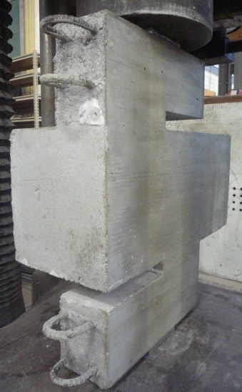
Horizontal Shear in U-Beams
critical interface
bottom flange
web

Slide 96


Horizontal Shear in U-Beams
bottom flange
web
OFFSET BAR
CENTERED BAR

Slide 97

Horizontal Shear in U-Beams
$$T$$
$$T$$

Slide 98
Modified Push-Off Results
Calculated capacity = 74.4 kip
 |  | Centered | Offset
Series 1 | Measured Value | 67.4 kip | 54.7 kip
Series 2 | Measured Value | 73.2 kip | 60.1 kip

Slide 99
Modified Push-Off Results
Calculated capacity = 74.4 kip
 |  | Centered | Offset
Series 1 | Measured Value | 67.4 kip | 54.7 kip
 | Ratio to Calculated | 0.91 | 0.73
Series 2 | Measured Value | 73.2 kip | 60.1 kip
 | Ratio to Calculated | 0.98 | 0.81

Slide 100
Modified Push-Off Results
 |  | Centered | Offset | Ratio: | Offset
 |  |  |  |  | Centered
Series 1 | Measured Value | 67.4 kip | 54.7 kip | 0.81
 | Ratio to Calculated | 0.91 | 0.73
Series 2 | Measured Value | 73.2 kip | 60.1 kip | 0.82
 | Ratio to Calculated | 0.98 | 0.81
for U-Beams with offset reinforcement
(i.e., no supplementary bars), reduce
capacity with $k_{d}$ equal to 0.8

Slide 101
Horizontal Shear Evaluation
$$\frac{V_{u_{hs}}}{V_{ni}}$$
Some Horizontal Shear Damage
No Horizontal Shear Damage
$${V_{test}}/{V_{n}}$$
[calculated using AASHTO General Procedure]

